Slide 1






Introduction to Terraform
utrains.org

Slide 2
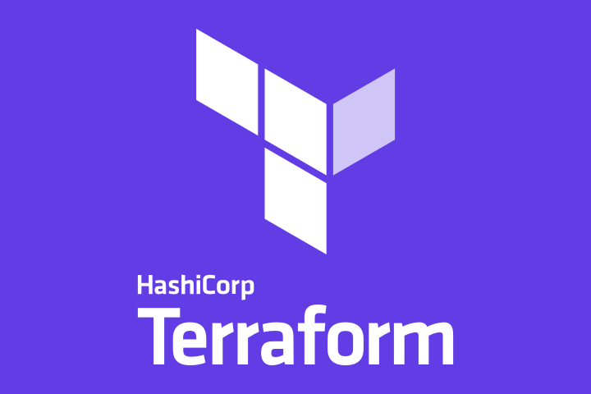

Slide 3
Table of content
Why Terraform?
What is Terraform?
Terraform Core concepts
Terraform Lifecycle
How Terraform works
Installing Terraform
Provision AWS EC2 instance using Terraform
Project: deploy a three tier architecture on AWS with terraform

Slide 4



1.
Why Terraform?
Introduction: IaC

Slide 5
Introduction
The cloud gives us the ability to create our environments quickly, but the problem that arises is how to configure and manage those environments.
Manually updating from the console may be acceptable for a small organization in a single region, but what if you have to create and maintain environments in multiple regions?
Not only is it an inefficient use of time to create and maintain everything, but it’s also error-prone.

Slide 6
Introduction
Take this example:
Imagine that you are asked to create an environment in a single Region.
Not really a big deal and you are able to complete the task with relative ease.
Now you need to do the exact same thing for five more Regions!
Not only that, once you have completed the task, your leadership asks you to make a change that then needs to be applied to all Regions!
This example is inefficiency at its finest.

Slide 7
Introduction: IaC
Infrastructure as Code (IaC) is a widespread terminology among DevOps professionals.
It is the process of managing and provisioning the complete IT infrastructure (comprises both physical and virtual machines) using machine-readable definition files.
It is a software engineering approach toward operations.
It helps in automating the complete data center by using programming scripts.

Slide 8
Think about Infrastructure as Code as a scalable blueprint for your environment.
It allows you to provision and configure your environments in a reliable and safe way.
By using code to deploy your infrastructure you gain the ability to use the same tools as developers such as version control, testing, code reviews, and CI/CD.

Slide 9








IaC Challenges
Why Terraform?

Slide 10
Challenges
With all the features that Infrastructure as Code provides, it has multiple challenges:
Need to learn to code
Don’t know the change impact.
Need to revert the change
Can’t track changes
Can’t automate a resource
Multiple environments for infrastructure
Terraform has been created to solve these challenges

Slide 11
2.
What is Terraform?
Introduction

Slide 12
What is Terraform?
Terraform is an open-source infrastructure as Code tool developed by HashiCorp.
It is used to define and provision the complete infrastructure using an easy-to-learn declarative language.
It is an infrastructure provisioning tool where you can store your cloud infrastructure setup as codes.
It’s very similar to tools such as CloudFormation, which you would use to automate your AWS infrastructure, but you can only use that on AWS.
With Terraform, you can use it on other cloud platforms as well.

Slide 13
The benefits of using Terraform
What are some benefits of using it?

Slide 14
What is Terraform: Benefits
Below are some of the benefits of using Terraform.
It does orchestration, not just configuration management
It supports multiple providers such as AWS, Azure, GCP, DigitalOcean and many more
It provides immutable infrastructure where configuration changes smoothly
It uses easy to understand language, HCL (HashiCorp configuration language)
It is easily portable to any other provider
It supports Client only architecture, so no need for additional configuration management on a server

Slide 15
3.
Terraform Core concepts
What are some terminologies used in Terraform?

Slide 16
Terraform Core concepts
There are some core concepts/terminologies used in Terraform such as:
Variables: Also used as input-variables, it is key-value pair used by Terraform modules to allow customization.
Provider: It is a plugin to interact with APIs of service and access its related resources.
Module: It is a folder with Terraform templates where all the configurations are defined
State: It consists of cached information about the infrastructure managed by Terraform and the related configurations.

Slide 17
Terraform Core concepts
We also have as terminologies:
Resources: It refers to a block of one or more infrastructure objects (compute instances, virtual networks, etc.), which are used in configuring and managing the infrastructure.
Data Source: It is implemented by providers to return information on external objects to terraform.
Output Values: These are return values of a terraform module that can be used by other configurations.

Slide 18
Terraform Core concepts
Plan: It is one of the stages where it determines what needs to be created, updated, or destroyed to move from real/current state of the infrastructure to the desired state.
Apply: It is one of the stages where it applies the changes real/current state of the infrastructure in order to move to the desired state

Slide 19
4.
Terraform Lifecycle
Init-plan-apply-destroy

Slide 20
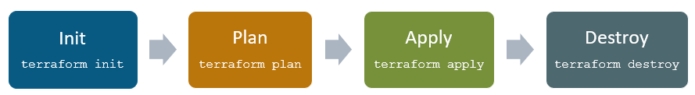
Terraform lifecycle
Terraform lifecycle consists of four steps : init, plan, apply, and destroy.

Slide 21
Terraform lifecycle
Terraform init initializes the working directory which consists of all the configuration files
Terraform plan is used to create an execution plan to reach a desired state of the infrastructure. Changes in the configuration files are done in order to achieve the desired state.
Terraform apply then makes the changes in the infrastructure as defined in the plan, and the infrastructure comes to the desired state.
Terraform destroy is used to delete all the old infrastructure resources, which are marked tainted after the apply phase.

Slide 22
5.
How Terraform works?
Terraform core and Providers

Slide 23
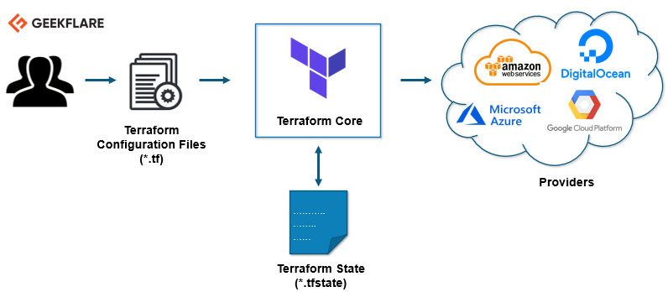
How Terraform works
Terraform has two main components that make up its architecture: Terraform Core and Providers

Slide 24
Terraform Core
Terraform components/Architecture

Slide 25
How Terraform works: Terraform Core
Terraform core uses two input sources to do its job:
The first input source is a Terraform configuration that you, as a user, configures.
Here, you define what needs to be created or provisioned.
And the second input source is a state where terraform keeps the up-to-date state of how the current set up of the infrastructure looks like.

Slide 26
How Terraform works: Terraform Core
So, what terraform core does is, it takes the input, and it figures out the plan of what needs to be done.
It compares the state, what is the current state, and what is the configuration that you desire in the end result.
It figures out what needs to be done to get to that desired state in the configuration file.
It figures out what needs to be created, what needs to be updated, what needs to be deleted to create and provision the infrastructure.

Slide 27
Terraform Providers
Terraform components/Architecture

Slide 28
How Terraform works: Providers
The second component of the architecture are providers for specific technologies.
This could be cloud providers like AWS, Azure, GCP, or other infrastructure as a service platform.
It is also a provider for more high-level components like Kubernetes or other platform-as-a-service tools, even some software as a self-service tool.
It gives you the possibility to create infrastructure on different levels.

Slide 29
How Terraform works: Providers
For example: Create an AWS infrastructure, then deploy Kubernetes on top of it and then create services/components inside that Kubernetes cluster.
Terraform has over a hundred providers for different technologies, and each provider then gives terraform user access to its resources.
So through AWS provider, for example, you have access to hundreds of AWS resources like EC2 instances, the AWS users, etc.
With Kubernetes provider, you access to commodities, resources like services and deployments and namespaces, etc.

Slide 30
So, this is how Terraform works, and this way, it tries to help you provision and cover the complete application setup from infrastructure all the way to the application.
Now, we will install Terraform on Ubuntu and provision a very basic infrastructure.

Slide 31
6.
Installing Terraform
On Ubuntu

Slide 32
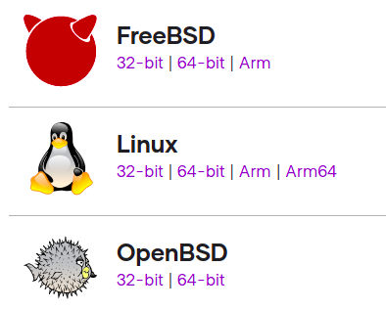
Installing Terraform on Ubuntu
To install Terraform, we will download the latest package.
We will refer to the official download page (https://www.terraform.io/downloads.html) to get the latest version for the respective OS.
Scroll down the page to the Linux version
Right click on the 64-bit version and click on Copy the link address

Slide 33
Installing Terraform on Ubuntu
Boot up your Ubuntu server and launch a terminal
Download the package using wget command: wget Paste the link
That is:
wget https://releases.hashicorp.com/terraform/1.0.1/terraform_1.0.1_linux_amd64.zip
Now, extract the downloaded package with: unzip terraform_1.0.1_linux_amd64.zip

Slide 34
Installing Terraform on Ubuntu
Now, move the terraform executable file to the path shown below.
sudo mv terraform /usr/local/bin/
Enter your password
Check the terraform version with the command: terraform -v
If you run the command terraform in your terminal you will see the usage and the various terraform commands for execution.

Slide 35
7.
Provision AWS EC2 instance using Terraform
Launch an EC2 instance in AWS

Slide 36
Provision AWS EC2 instance
In this part, we are going to launch a new EC2 instance in AWS using Terraform
First, let’s create a directory on our system for that: mkdir terraform_demo
Let’s go to the directory and create a terraform configuration file where we will define the provider and resources to launch an AWS EC2 instance.
cd terraform_demo
gedit awsec2.tf

Slide 37
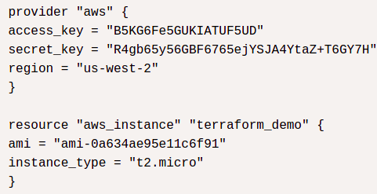
Provision AWS EC2 instance
Your awsec2.tf file should look like this:
NB: Put your own aws access_key and secret_key (for your aws account)
Remember to modify the region according to your location as well
Save and exit

Slide 38
Provision AWS EC2 instance
Now, let’s initialize with the command: terraform init
Next is the plan stage; it will create the execution graph for creating and provisioning the infrastructure
To do that, run the command terraform plan
The apply stage will execute the configuration file and launch an AWS EC2 instance. Run the command: terraform apply
When you run apply command, it will ask you, “Do you want to perform these actions?”, you need to type yes and hit enter.

Slide 39
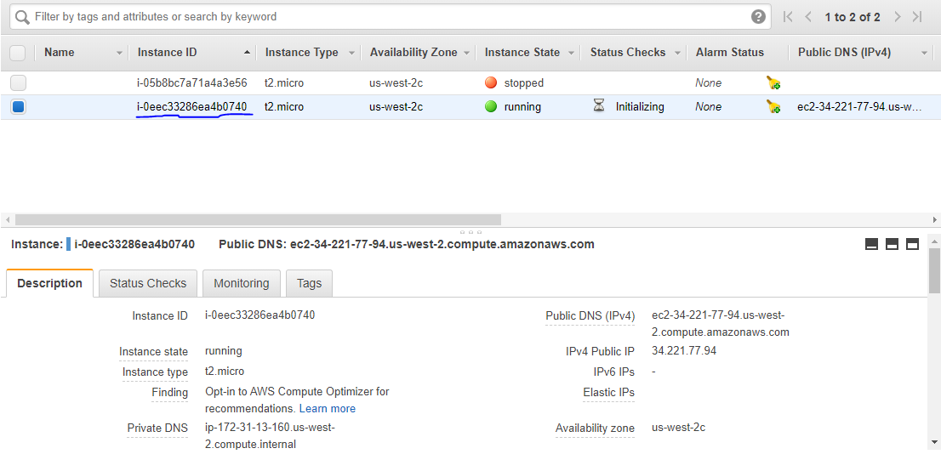
Provision AWS EC2 instance
When the process is completed, go to your AWS EC2 dashboard, and you will see that a new instance with the instance id mentioned at the end of the apply command has been created.

Slide 40
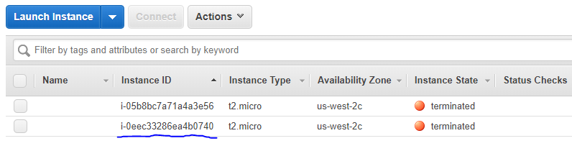
Provision AWS EC2 instance
You have successfully launched an AWS EC2 instance using Terraform.
Finally, if you want to delete the infrastructure, you need to run the destroy command: terraform destroy
When the process is completed, check your AWS instances

Slide 41
8.
Project: Deploy a three tier architecture in AWS
On Ubuntu

Slide 42
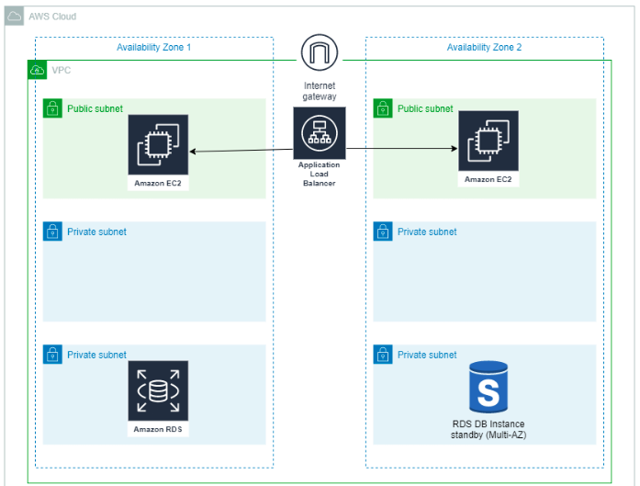

Slide 43
The code we will use for this project is found in a github repository at:
https://github.com/troy-ingram/terraform/tree/main/three-tier-architecture
As prerequisite to start this project you must:
Install Terraform
Install the AWS CLI
Have an AWS account as well

Slide 44
Deploy Three tier architecture
First, create a new directory for this project on your system
Inside the new directory create a file named install_apache.sh
Now go to the provided github link, copy the code from the install_apache.sh file and paste it in the file you created previously using gedit, vi or any editor
NB: This code will :
Install an Apache web server on our instances
And create a unique landing page for each so we can verify the Application Load Balancer is working.

Slide 45
Deploy Three tier architecture
Now, let’s configure the Provider
In your project directory, create a new file called main.tf
Now go to the provided github link, copy the code from the main.tf file and paste it the file you created previously using gedit or vi
We will declare our Provider as AWS as you can see in the first section of the code.
The file contains various sections (as precise in the comment line before each section)
Go through the file to better understand each section and its function

Slide 46
Deploy Three tier architecture
Now, let’s provision the infrastructure
From the terminal run terraform init to initialize .
Run terraform fmt to ensure your formatting is correct and will modify the code for you to match.
Run terraform validate to ensure there are no syntax errors.
Run terraform plan to see what resources will be created.
Run terraform apply to create your infrastructure. Type Yes when prompted.

Slide 47
Testing
Terraform-AWS

Slide 48
Deploy Three tier architecture
After your infrastructure has been created there should be an Output displayed on your terminal for the Application Load Balancer DNS Name.
Copy and paste (without quotations) into a new browser tab.
Refresh the page to see the load balancer switch between the two instances.
To delete our infrastructure run terraform destroy .
When prompted type Yes to delete all the infrastructure that we created.
Check your AWS account to make sure this works!

Slide 49
Sources:
https://aws.plainenglish.io/terraform-deploying-a-three-tier-architecture-in-aws-4c8ecce40790
https://geekflare.com/terraform-for-beginners/
Check the links to better understand the concept especially for the project part.
Also do more research on google or youtube to finetune your knowledge

Slide 50

Thanks!
Any questions?
You can find us at:
website: https://utrains.org/
Phone: +1 (302) 689 3440
Email: contact@unixtrainings.com

Slide 51
Click on the link below to contact the support team for any issue!
https://utrains.org/support/
Create a ticket for your problem and we will get back to you soon!

